Slide 1
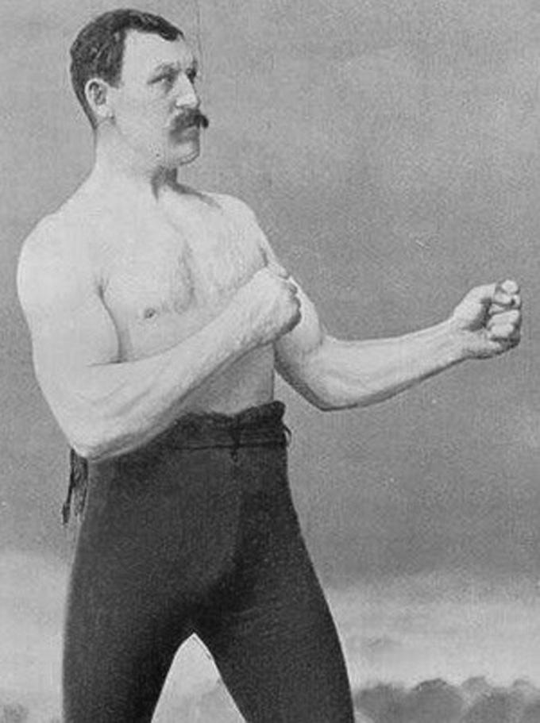
MCOSS2WED
Media Queries & Responsive Menu

Slide 2
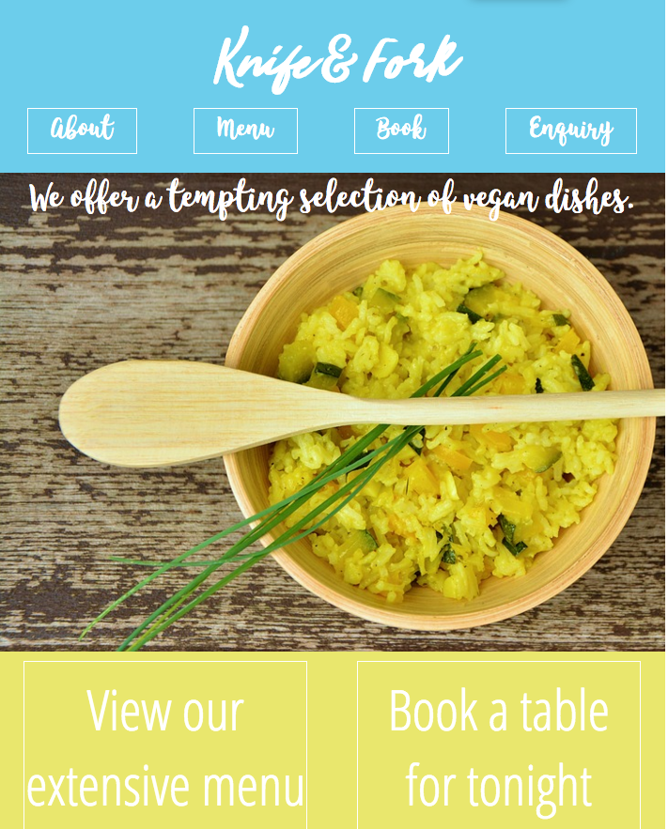
Example
Open index-dropdown.html and style-dropdown.css

Slide 3
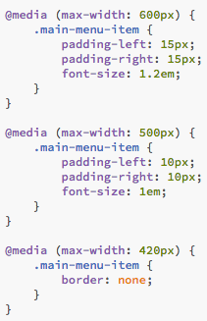
Media queries
There are several media queries used in the CSS to control the size of the menu button text.
Resizing the browser window shows the media queries in action.

Slide 4

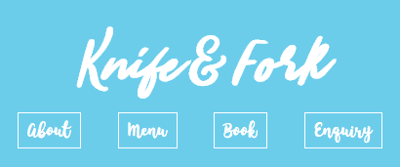
Media queries
> 600px
< 600px
< 500px

Slide 5


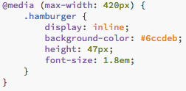
Media queries
At 420px or less, the main menu is hidden and a hamburger icon displayed:
< 420px

Slide 6
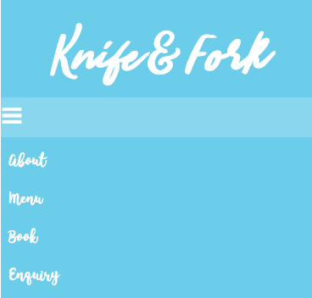
Media queries
This will (hopefully!) give the impression that the main menu collapses into the hamburger icon.
The user can click the hamburger to view a vertical menu.
This is useful on mobile devices and narrow browser widths.

Slide 7
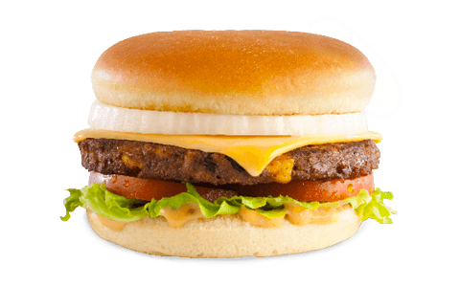
Creating a responsive menu
Follow along with a new HTML and CSS file for a responsive menu

Slide 8
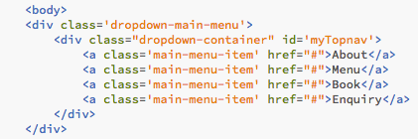

Add menu items
Add a few menu items to a div (give it a class and ID). (dropdown-example1.html).
Add some body styling if you wish (dropdown-example1.css).

Slide 9
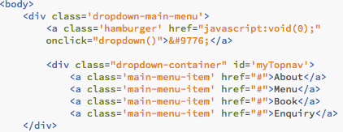
Add a hamburger
Add a hamburger icon (dropdown-example2.html).
This line also contains code to trigger the JS routine ‘dropdown’ when the hamburger icon is clicked.
&#9776 prints the hamburger character.

Slide 10
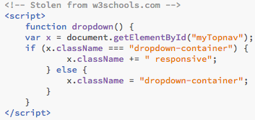
Add a some JavaScript
Add this JavaScript code (dropdown-example3.html):

Slide 11
JavaScript code explained
Script name is ‘dropdown’. This is run when the hamburger icon is clicked.

Slide 12
JavaScript code explained
When the routine is run, it looks for an element with the ID ‘myTopnav’.
The routine then checks to see if the class name is ‘dropdown-container’.

Slide 13
JavaScript code explained
If the class name matches, ‘responsive’ is appended to it. It can now be referred to by the class name ‘dropdown-container.responsive’
If the element’s class is already set to ‘dropdown-container.responsive’ then it is reset to simply ‘dropdown-container’

Slide 14
JavaScript code explained
This means that when the hamburger icon is clicked, the class name (picked by matching the ID ‘myTopnav’) toggles between:
‘dropdown-container’ & ‘dropdown-container.responsive’

Slide 15
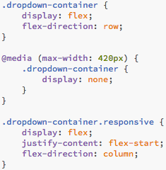
JavaScript code explained
This function allows the styling of an element in two different ways depending upon whether the element’s class is
‘dropdown-container’
or
‘dropdown-container.responsive’

Slide 16
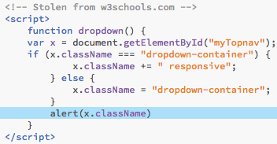
JavaScript code explained
If we need to troubleshoot this JS function, we can do so by adding an alert command to tell us the current value of the class.

Slide 17
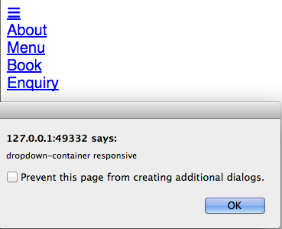
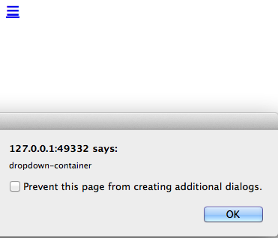
JavaScript code explained
Now, when we click the hamburger icon, a JavaScript alert dialogue will present itself displaying the current value of the class:
dropdown-example3a.html

Slide 18
Hiding the hamburger
We still have a few things to do.
We need to hide the hamburger icon for screen widths above 420 pixels.

Slide 19
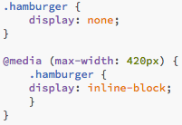
Hiding the hamburger
This can be achieved using a media query (dropdown-example3.css):

Slide 20
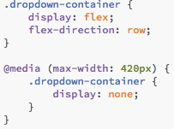
Hiding the menu items
We need to hide the menu items for screen widths below 420 pixels.

Slide 21
Add a vertical responsive menu
When the viewport width is below 420px and the hamburger icon is clicked, we need to display a vertical menu.
We have a menu already so we can just re-style it depending upon its class when the hamburger icon is clicked.

Slide 22

Add a vertical responsive menu
Adding the following to CSS will produce this (remember that the text ‘responsive’ is going to be appended to the class):

Slide 23



Tidying up
Take a look at what you’ve got so far.
Try resizing the browser window.
Normal menu with browser width above 420px.
Hamburger icon appears when the browser width falls below 420px.
The vertical menu appears when the hamburger icon is clicked.

Slide 24
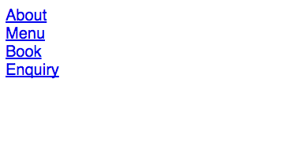
Tidying up
However, the vertical menu stays on the screen when the browser window is resized above 420px

Slide 25
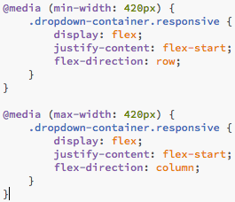
Tidying up
To remedy this, we can use media queries to rearrange the menu on browser widths above and below 420px (dropdown-example4.html).

Slide 26
Summary
Your responsive menu should be fully functional now.
It should rearrange itself back to a horizontal display (flex-display: row) even if it is left in its vertical state after the hamburger is clicked and the browser window is then enlarged.

